Slide 1
SUPPORT VECTOR MACHINES
Joseph Nelson, Data Science Immersive

Slide 2
Agenda
To the basics: class separation and margins
What is a Support Vector Machine?
How SVM Works
Nonlinear SVM (Different Kernels)
Coding Implementation
Sklearn documentation

Slide 3
Agenda
What is a Support Vector Machine?
How SVM Works
Nonlinear SVM (Different Kernels)
Coding Implementation
Sklearn documentation

Slide 4
What is the goal of classification?
1.) What is classification?
2.) What are we striving to do?
3.) What does this look like mathematically/visually?

Slide 5
What is the goal of classification?
Imagine we have read class and blue class, and plotted, they look like this graph.
What is the ideal separation boundary given this distribution?

Slide 6
What is the goal of classification?
Imagine we have read class and blue class, and plotted, they look like this graph.
Option 1

Slide 7
What is the goal of classification?
Imagine we have read class and blue class, and plotted, they look like this graph.
Option 2

Slide 8
What is the goal of classification?
Imagine we have read class and blue class, and plotted, they look like this graph.
Option 3

Slide 9
What is the goal of classification?
Which is best?
Option 1
Option 2
Option 3

Slide 10
INtuition
Winner
Option 1
Option 2
Option 3

Slide 11
Intuition
Winner. Why?
What specific conditions can you define that makes this optimal?
Option 3

Slide 12
Intuition
In general, lots of possible solutions for a,b,c.
Support vector machine finds an optimal solution (with respect to what cost?)

Slide 13
Intuition
In general, lots of possible solutions for a,b,c.
Support vector machine finds an optimal solution (with respect to what cost?)

Slide 14
What is A support vector machine?
A Support Vector Machine is a binary linear classifier whose decision boundary is explicitly constructed to minimize generalization error
Binary classifier: solves a two-class problem
Linear classifier: creates a linear decision boundary

Slide 15
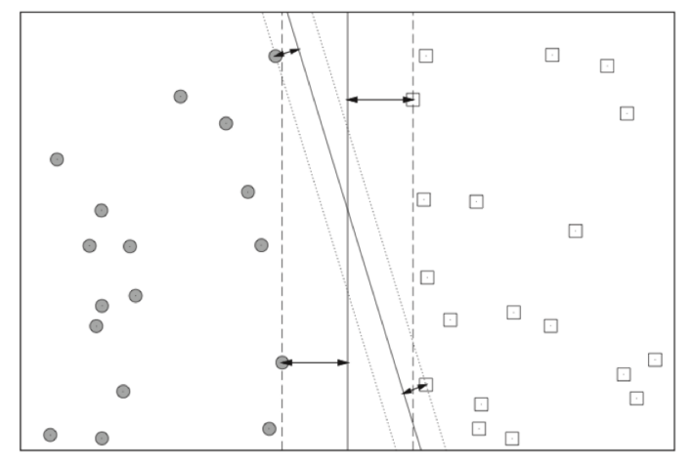
What is A support vector machine?
The decision boundary is derived using geometric reasoning (as opposed to the algebraic reasoning we’ve used to derive other classifiers). The generalization error is equated with the geometric concept of margin, which is the region along the decision boundary that is free of data points.
Notes:
Note the vertical line has a higher margin
The goal of an SVM is to create the linear decision boundary with the largest margin. This is commonly called the maximum margin hyperplane (MMH).

Slide 16
What is A support vector machine?
Finding the optimal hyperplane be like…
Notes:
Note the vertical line has a higher margin
The goal of an SVM is to create the linear decision boundary with the largest margin. This is commonly called the maximum margin hyperplane (MMH).

Slide 17
What is A support vector machine?
Support vectors are the elements of the training set that would change the position of the dividing hyperplane (UCF)
The quest to find the optimal hyper plane is an optimization problem
Because of this, support vector machines have discriminative solutions
Notes:
Diagram: UCF

Slide 18
Mathematically, what are we dealing with?
Let’s set up some definitions
x_{i} * w + b ≥ +1 when y_{i} = +1
x_{i} * w + b ≤ -1 when y_{i} = -1
H1: x_{i} * w + b = +1
H2: x_{i} * w + b = -1
d+ = the shortest distance to the closest positive point
d- = the shortest distance to the closest negative point
Notes:
Diagram: UCF

Slide 19
Sidenote: remember linear algebra represents lines
Remember that y = ax+b is the same as y – ax – b = 0
Given two vectors and
w^{T} x =−b×(1)+(−a)×x+1×y
w^{T} x = y−ax−b
Notes:
Diagram: UCF

Slide 20
Mathematically, what are we dealing with?
Given these conditions, note:
To have a closed form solution, our planes MUST be linearly separable.
We will not arrive at a solution if this is not the case. (For now, to be resolved later)
Notes:
Diagram: UCF

Slide 21
Mathematically, what are we dealing with?
So, what about solving those two constraints to find the ideal hyperplane?
We have: w⋅x_{i}+b≤−1 for class -1 (5)
Multiply both sides by -1: y_{i}(w⋅x_{i}+b)≥y_{i}(−1)
Which means we can write (5) as: y_{i}(w⋅x_{i}+b)≥1 for x_{i} having the class −1 (6)
Positive classes are identical: y_{i}(w⋅x_{i}+b)≥1 for x_{i} having the class 1 (7)
Combine (6) and (7): y_{i}(w⋅x_{i}+b)≥1 for all 1 ≤ i ≤ n
Notes:
http://www.svm-tutorial.com/2015/06/svm-understanding-math-part-3/

Slide 22
Mathematically, what are we dealing with?
We have the condition!
y_{i}(w⋅xi+b)≥1 for all 1 ≤ i ≤ n
Now we gotta solve this…
Notes:
http://www.svm-tutorial.com/2015/06/svm-understanding-math-part-3/

Slide 23
Mathematically, what are we dealing with?
y_{i}(w⋅xi+b)≥1 for all 1 ≤ i ≤ n
We are producing our own unit vector (measuring stick) that is orthagonal (perpendicular) to our hyperplanes
We want to maximize this length
Notes:
http://www.svm-tutorial.com/2015/06/svm-understanding-math-part-3/

Slide 24
Mathematically, what are we dealing with?
The math associated with solving this yields this condition:
This norm measures the distance between the hyperplanes. That means we want to maximize it.
Notes:
http://www.svm-tutorial.com/2015/06/svm-understanding-math-part-3/

Slide 25
Mathematically, what are we dealing with?
The math associated with solving this yields this condition:
This norm measures the distance between the hyperplanes. That means we want to maximize it.
But minimization problems are nicer: ½ w ^{T} w
Solving this relies on a quadratic programming problem use Lagrangian multiplier method
Notes:
http://www.svm-tutorial.com/2015/06/svm-understanding-math-part-3/

Slide 26
Mathematically, what are we dealing with?
“Solving this relies on a quadratic programming problem use Lagrangian multiplier method”
Thanks, Joseph
But for real: http://www.cs.ucf.edu/courses/cap6412/fall2009/papers/Berwick2003.pdf
http://www.svm-tutorial.com/2015/06/svm-understanding-math-part-3/

Slide 27
Back out of math-land
The goal of an SVM is to create the linear decision boundary with the largest margin. This is commonly called the maximum margin hyperplane (MMH).
Nonlinear applications of SVM rely on an implicit (nonlinear) mapping that sends vectors from the original feature space K into a higher-dimensional feature space K’. Nonlinear classification in K is then obtained by creating a linear decision boundary in K’. In practice, this involves no computations in the higher dimensional space, thanks to what is called the kernel trick.
Notes:
Note the vertical line has a higher margin
The goal of an SVM is to create the linear decision boundary with the largest margin. This is commonly called the maximum margin hyperplane (MMH).

Slide 28
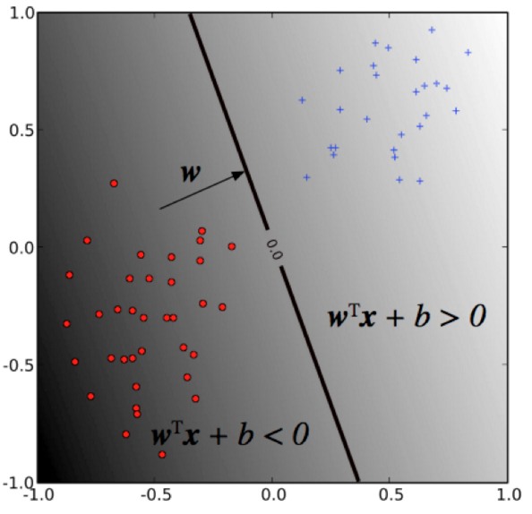
Decision boundary
The decision boundary (MMH) is derived by the discriminant function:
f(x) = w^{T} x + b
where w is the weight vector and b is the bias. The sign of f(x) determines the (binary) class label of a record x.

Slide 29
Decision boundary
Remember: SVM solves for the decision boundary that minimizes generalization error, or equivalently, that has the maximum margin. These are equivalent since using the MMH as the decision boundary minimizes the probability that a small perturbation in the position of a point produces a classification
Notes:
maximum margin hyperplane (MMH)

Slide 30
Decision boundary
Selecting the MMH is a straightforward exercise in analytic geometry
The margin depends only on a subset of the training data; namely, those points that are nearest to the decision boundary. These points are called the support vectors. The other points (far from the decision boundary) don’t affect the construction of the MMH at all.
Notes:
maximum margin hyperplane (MMH)
http://www.cs.columbia.edu/~kathy/cs4701/documents/jason_svm_tutorial.pdf
This formulation only works if the two classes are linearly separable, so that we can indeed find a margin to separate them. Usually however, classes are not separable, and there is partial overlap between them. This requires an extension of the formulation to accommodate for class overlap.

Slide 31
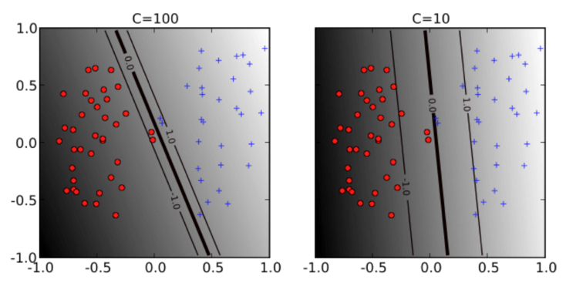
Soft Margin, slack variables
Class overlap is achieved by relaxing the minimization problem or softening the margin.
The hyper-parameter C (soft-margin constant) controls the overall complexity by specifying penalty for training error. This is yet another example of regularization.

Slide 32
Nonlinear svm
At its core, the optimization problem only has x as an inner product
f(x) = w^{T} x + b
We can replace this inner product with a more complex function: this is called the kernel trick
Popular kernels:
Linear k(x, x') = x^T x’
Polynomial k(x, x') = (x^T x' + 1)^d
Gaussian kernel (radial basis function) k(x, x') = \exp{(-\gamma||x - x'||^2)}

Slide 33
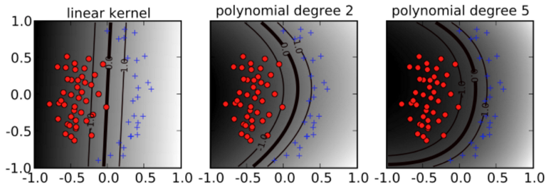
Nonlinear svm

Slide 34
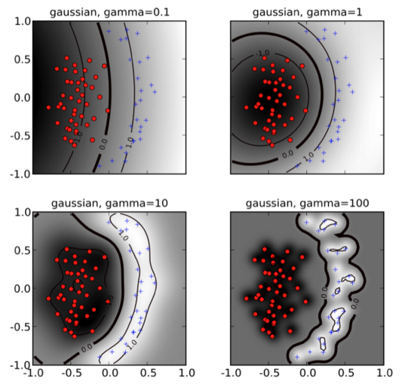
Nonlinear svm

Slide 35
Remember…
“SVMs are among the best (and many believe are indeed the best) “off-the-shelf” supervised learning algorithm.” - Andrew Ng

